Slide 1

Computer Network
Unit-5
Network Layer
Dr. Vijeta Khare

Slide 2

















Introduction: Network Layer
To deliver segment from sending to receiving host/ router. (Host to host)
On sending side, it encapsulates segments into datagrams.
On receiving side, it delivers segments to transport layer.
Network layer protocols in every host and router.
Router examines header fields in all IP datagrams passing through it.
application
transport
network
data link
physical
network
data link
physical
network
data link
physical
network
data link
physical
network
data link
physical
network
data link
physical
network
data link
physical
network
data link
physical
network
data link
physical
network
data link
physical
application
transport
network
data link
physical
network
data link
physical
network
data link
physical

Slide 3
IPv4
The Internet Protocol version 4 (IPv4) is the delivery mechanism used by the TCP/IP protocols.

Slide 4
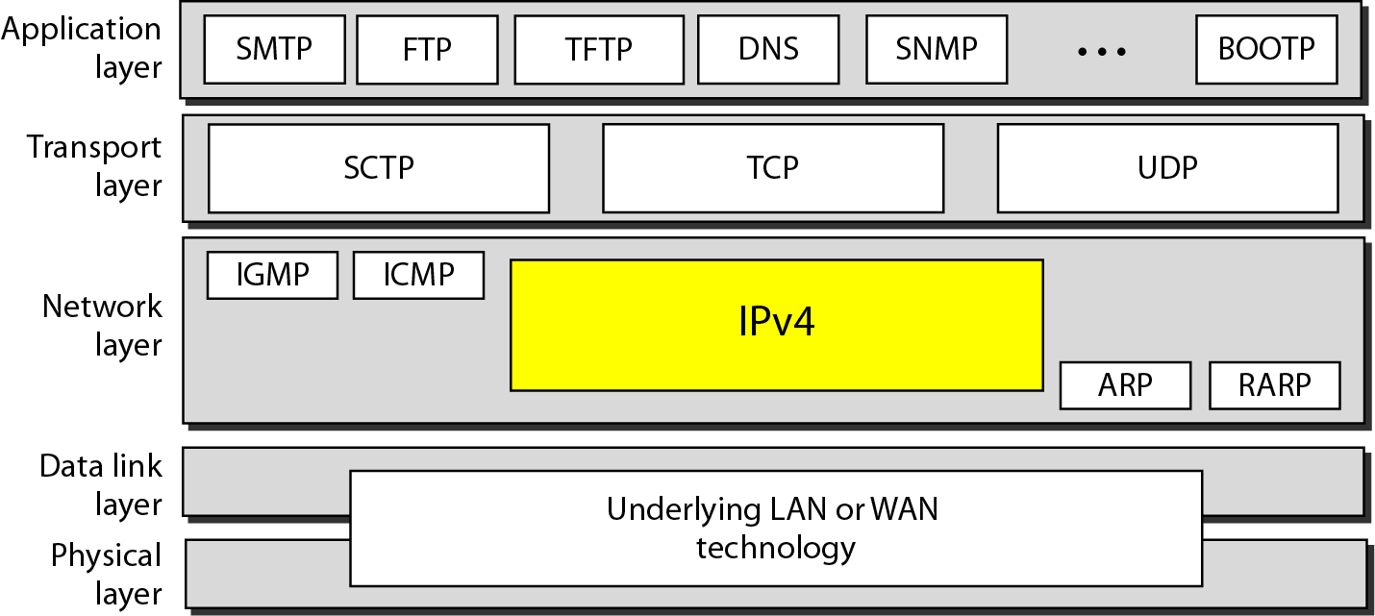
Figure 20.4 Position of IPv4 in TCP/IP protocol suite

Slide 5

Note
IPv4 is an unreliable and connectionless datagram protocol – a best effort delivery
Best effort means that IPv4 provides no error control (except for error detection on the header) or flow control
IPv4 does its best to get a transmission through to its destination, but with no guarantees

Slide 6
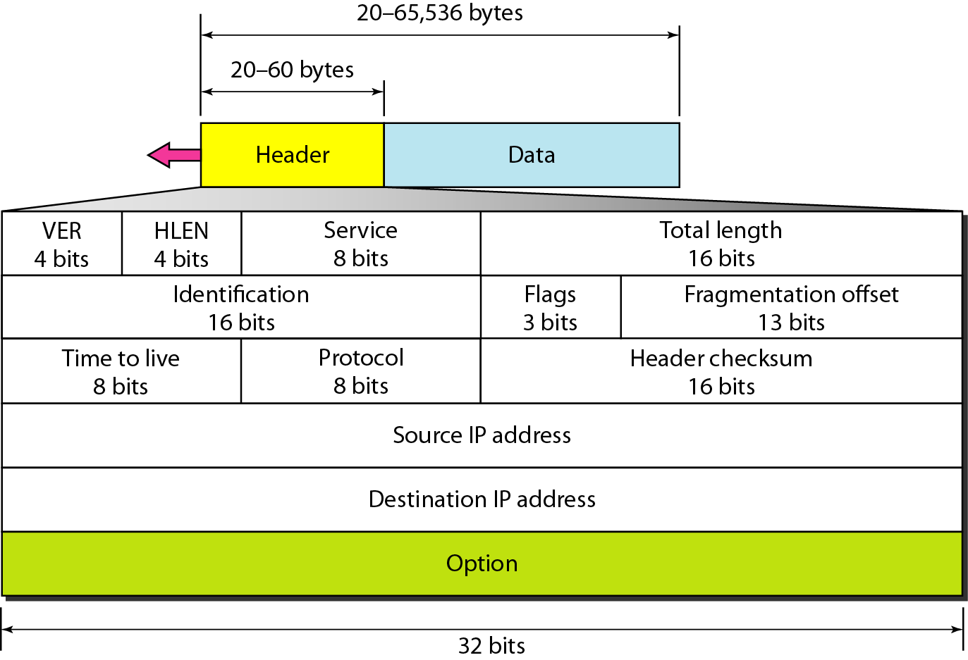
Figure 20.5 IPv4 datagram format

Slide 7
IPv4 Datagram Format
Version (VER): version of the IP protocol. Currently, the version is 4.
Header length (HLEN): the total length of the datagram header in 4-byte words.
Services: service type or differentiated services (not used now).
Total length: total length (header plus data) of the datagram in bytes.
Total length of data = total length – header length

Slide 8
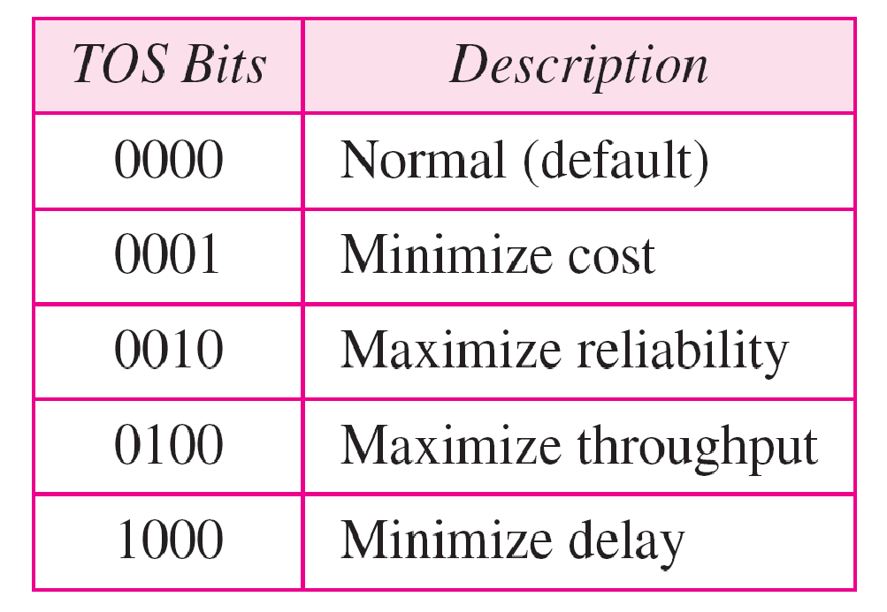
Table 20.1 Types of service

Slide 9
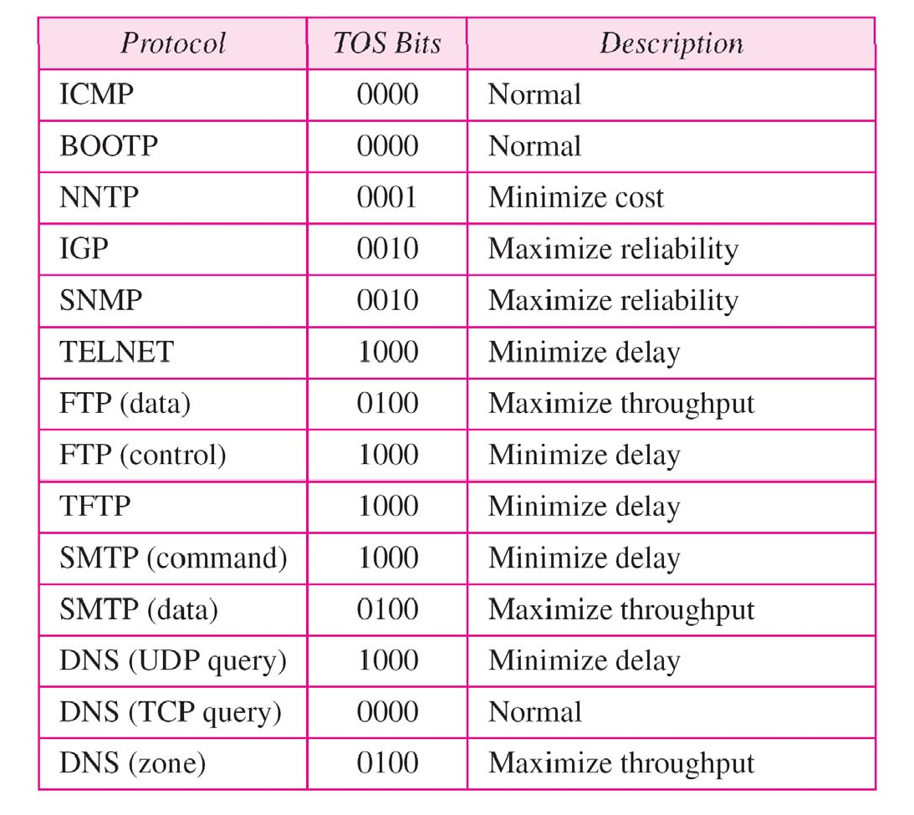
Table 20.2 Default types of service

Slide 10
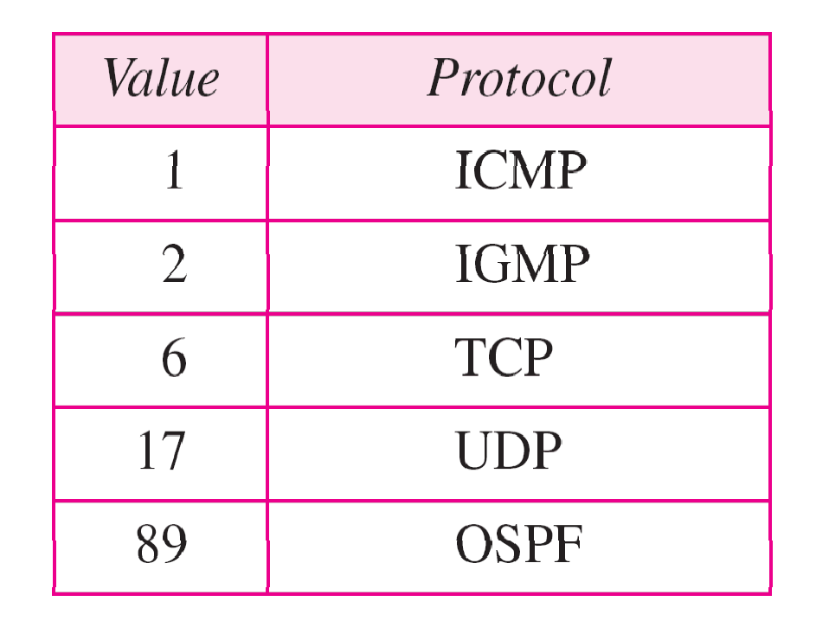
Table 20.3 Values for codepoints

Slide 11
IPv4 Datagram Format
Identification: used in fragmentation (discussed later).
Flags: used in fragmentation (discussed later).
Fragmentation offset: used in fragmentation (discussed later).
Time to live: it is used to control the maximum number hops visited by the datagram.
Protocol: defines the higher-level protocol that uses the services of the IPV4 layer.

Slide 12
IPv4 Datagram Format
Checksum: 1’s compliment checksum
Source address: is the IPv4 address of the source.
Destination address: is the IPv4 address of the destination.

Slide 13

Fragmentation
A datagram can travel through different networks. Each router decapsulates the IPv4 datagram from the frame it receives, processes it, and then encapsulates it in another frame.
The format and size of the received frame depend on the protocol used by the physical network through which the frame has just traveled. The format and size of the sent frame depend on the protocol used by the physical network through which the frame is going to travel.
For example, if a router connects a LAN to a WAN, it receives a frame in the LAN format and sends a frame in the WAN format.

Slide 14
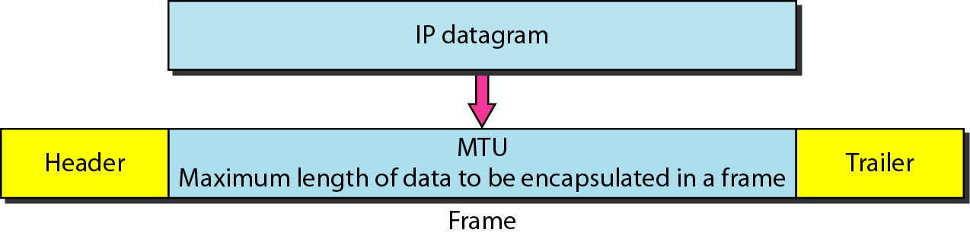
To make the IPv4 protocol independent of the physical network, the designers decided to make the maximum length of the IPv4 datagram equal to 65,535 bytes.
This makes transmission more efficient if we use a protocol with an MTU of this size. However, for other physical networks, we must divide the datagram to make it possible to pass through these networks. This is called fragmentation.
The source usually does not fragment the IPv4 packet. The transport layer will instead segment the data into a size that can be accommodated by IPv4 and the data link layer in use.
When a datagram is fragmented, each fragment has its own header with most of the fields repeated, but with some changed.

Slide 15
Fields Related to Fragmentation
Identification: identifies a datagram originating from the source host. A combination of the identification and source address must uniquely define a datagram as it leaves the source node.
Flags: see next slide.
Fragmentation offset: is the offset of the data in the original datagram measured in units of 8 bytes.

Slide 16

Figure 20.10 Flags (3 bits) used in fragmentation
first bit: reserved (not used)
second bit: = 1 requires the packet not to be fragmented
drops the packet if it is > MTU
third bit: =1 more fragmented packets later
=0 the last fragmented packet

Slide 17
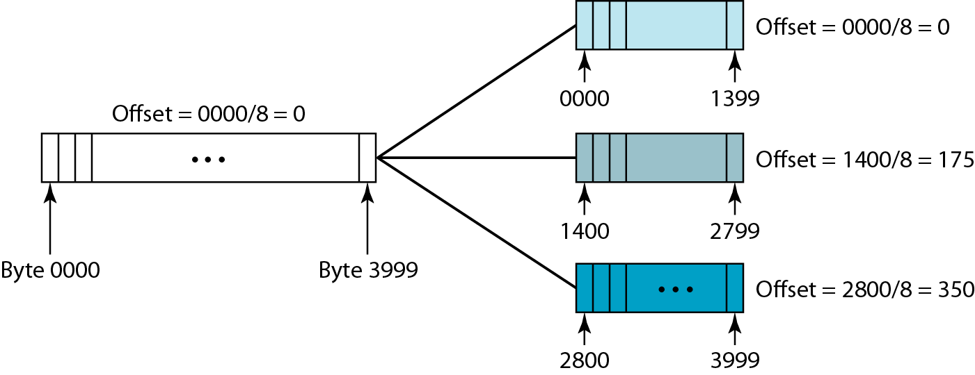
Figure 20.11 Fragmentation example

Slide 18
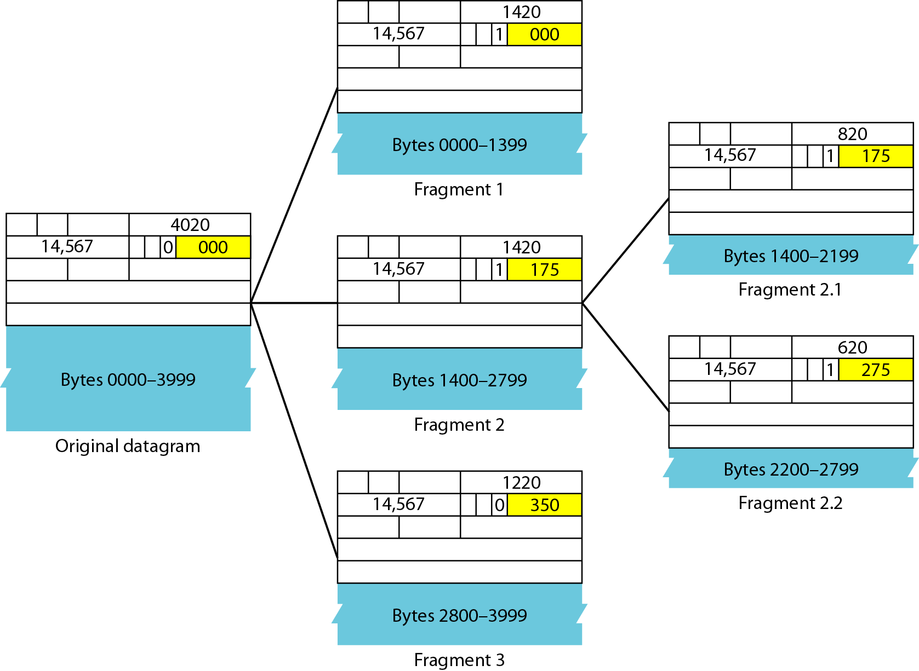
Figure 20.12 Detailed fragmentation example

Slide 19

IP Addressing - Example
IP address: It is 32-bit identifier for host, router interface
Interface: It is a connection between host/router and physical link.
A router’s typically have multiple interfaces
A host typically has one or two interfaces
IP addresses associated with each interface.
223.1.1.1
223.1.2.1
223.1.1.2
223.1.1.4
223.1.2.9
223.1.1.3
223.1.3.27
223.1.2.2
223.1.3.1
223.1.3.2
223.1.1.1 = 11011111 00000001 00000001 00000001
223
1
1
1

Slide 20
IP Address
IP addresses are useful in identifying a specific host in a network.
IP addresses are 32 bit numbers which are divided into 4 octets. Each octet represents 8 bit binary number.
Below is an example of an IP address:
10101100
00010000
11111110
00000001
172
16
254
1
IP addresses are divided into 2 parts:
Network ID & Host ID
<NID> <HID> = IP Address

Slide 21
Classification of IP Addresses (Classful Addressing)
Class: A
0
7 Bit Network ID
24 Bit Host ID
Fix
Class: B
1 | 0
Fix
14 Bit Network ID
16 Bit Host ID
Class: C
1 | 1 | 0
Fix
21 Bit Network ID
8 Bit Host ID
Class: D
1 | 1 | 1 | 0
Fix
Class: E
Multicast address
1 | 1 | 1 | 1
Fix
Reserved address

Slide 22
Class A: Range(0.0.0.0 to 127.255.255.255) Dotted decimal notation
Only 126 addresses are used for network address.
All 0’s and 1’s in Network-ID are dedicated for special IP address. So, total number of IP address in class A can be represented:
0
7 Bit Network ID
24 Bit Host ID
0.0.0.0 | Special IP Address
00000001.0.0.1 1.0.0.2 1.0.0.3 . . . 126.255.255.254 | 2²⁴ – 2 are Host IP
127.255.255.255 | Special IP Address – Loopback

Slide 23
Class B: Range (128.0.0.0 to 191.255.255.255)
1 | 0
Fix
14 Bit Network ID
16 Bit Host ID
128.0.0.0 | Special IP Address
10000001.0.0.1 130.0.0.2 130.0.0.3 . . . 190.255.255.254 | 2¹⁶ – 2 are Host IP
10111111.255.255.255 | Special IP Address – Loopback

Slide 24
Class C: Range(192.0.0.0 to 223.255.255.255)
1 | 1 | 0
Fix
21 Bit Network ID
8 Bit Host ID
192.0.0.0 | Special IP Address
11000001.0.0.1 194.0.0.2 194.0.0.3 . . . 222.255.255.254 | 2⁸ – 2 are Host IP
11011111.255.255.255 | Special IP Address – Loopback

Slide 25
Class D: Range (224.0.0.0 to 239.255.255.255)
Very first four bits of the first octet in Class D IP addresses are set to 1110, giving a range of:
Class D has IP address rage from 224.0.0.0 to 239.255.255.255.
Class D is reserved for Multicasting.
In multicasting data is not destined for a particular host, that is why there is no need to extract host address from the IP address, and Class D does not have any subnet mask.

Slide 26
Class E: (240.0.0.0 to 255.255.255.255)
This IP Class is reserved for experimental purposes only for R&D or Study.
IP addresses in this class ranges from 240.0.0.0 to 255.255.255.254.
Like Class D, this class too is not equipped with any subnet mask.

Slide 27
Type of addresses in IPv4 Network
Network address - The address by which we refer to the network.
E.g.: 10.0.0.0
Broadcast address - A special address used to send data to all hosts in the network.
The broadcast address uses the highest address in the network range.
E.g.: 10.0.0.255
Host addresses - The addresses assigned to the end devices in the network.
E.g.: 10.0.0.1

Slide 28
Type of addresses – Cont…

Slide 29
Assignment
Change the following IP addresses from dotted-decimal notation to binary notation.
a. 114.34.2.8
b. 129.14.6.8
2. Change the following IP addresses from binary notation to dotted-decimal notation.
a. 01111111 11110000 01100111 01111101
b. 10101111 11000000 11111000 00011101
3. Find the class of the following IP addresses.
a. 11110111 11110011 10000111 11011101
b. 10101111 11000000 11110000 00011101
4. Find the netid and the hostid of the following IP addresses.
a. 114.34.2.8
b. 132.56.8.6

Slide 30
Masking Example To extract network and host network
Extract network:
IP Address:
10110101 11011101 01010100 01110010
Mask:
& 11111111 11111111 00000000 00000000
Result:
10110101 11011101 00000000 00000000
Extract host:
IP Address:
10110101 11011101 01010100 01110010
Subnet Mask:
& ~(11111111 11111111 00000000 00000000)
Result:
00000000 00000000 01010100 01110010

Slide 31
Subnets
Problem: need to break up large A and B classes
Solution: add another layer to the hierarchy
From the outside, appears to be a single network
Only 1 entry in routing tables
Internally, manage multiple subnetworks
Split the address range using a subnet mask
Pfx
Ntwk
Subnet
Host
Subnet Mask:
11111111 11111111 11000000 00000000

Slide 32
Subnet Example
Extract network:
IP Address:
10110101 11011101 01010100 01110010
Subnet Mask:
& 11111111 11111111 11000000 00000000
Result:
10110101 11011101 01000000 00000000
Extract host:
IP Address:
10110101 11011101 01010100 01110010
Subnet Mask:
& ~(11111111 11111111 11000000 00000000)
Result:
00000000 00000000 00010100 01110010

Slide 33
Classless Inter-Domain Routing(CIDR)
CIDR is a slash notation of subnet mask. CIDR tells us number of on bits in a network address.
A single IP address can be used to designate many unique IP addresses with CIDR.
A CIDR IP address looks like a normal IP address except that it ends with a slash followed by a number, called the IP network prefix.
CIDR addresses reduce the size of routing tables and make more IP addresses available within organizations.
subnet
part
host
part
11001000 00010111 00010000 00000000
200.23.16.0/23

Slide 34
Subnetting
Subnetting take places when we extend the default subnet mask.
We cannot perform subnetting with default subnet mask and every classes have default subnet mask.
Now find the host bits borrowed to create subnets and convert them in decimal.
For example find the subnet mask of address 188.25.45.48/20 ?
Class B, Default Subnet mask: 255.255.0.0
Borrowed 4 bit from host part so mask is now:
11111111 11111111 11110000 00000000
255 255 240 0

Slide 35
How many subnets from given subnet mask?
To calculate the number of subnets provided by given subnet mask we use 2^{N} , where N = number of bits borrowed from host bits to create subnets.
For example in 192.168.1.0/27, N is 3.
By looking at address we can determined that this address is belong to class C and default subnet mask 255.255.255.0 [/24 in CIDR].
In given address we borrowed 27 - 24 = 3 host bits to create subnets.
Now 2³ = 8, so our answer is 8 (number of subnets ).

Slide 36
What are the total hosts?
Total hosts are the hosts available per subnet
To calculate total hosts use formula 2^{H} = Total hosts
H is the number of host bits
For example in address 192.168.1.0/26
We have 32 - 26
[Total bits in IP address - Bits consumed by network address] = 6
Total hosts per subnet would be 2⁶ = 64

Slide 37
IP Addressing Summary
Class | Leading bits | Size of network number bit field | Size of rest bit field | Number of networks | Addresses per network | Total addresses in class | Start address | End address | Default subnet mask in dot-decimal notation | CIDR notation
Class A | 0 | 8 | 24 | 128 (2⁷) | 16,777,216 (2²⁴) | 2,147,483,648 (2³¹) | 0.0.0.0 | 127.255.255.255 | 255.0.0.0 | /8
Class B | 10 | 16 | 16 | 16,384 (2¹⁴) | 65,536 (2¹⁶) | 1,073,741,824 (2³⁰) | 128.0.0.0 | 191.255.255.255 | 255.255.0.0 | /16
Class C | 110 | 24 | 8 | 2,097,152 (2²¹) | 256 (2⁸) | 536,870,912 (2²⁹) | 192.0.0.0 | 223.255.255.255 | 255.255.255.0 | /24
Class D (multicast) | 1110 | not defined | not defined | not defined | not defined | 268,435,456 (2²⁸) | 224.0.0.0 | 239.255.255.255 | not defined | not defined
Class E (reserved) | 1111 | not defined | not defined | not defined | not defined | 268,435,456 (2²⁸) | 240.0.0.0 | 255.255.255.255 | not defined | not defined

Slide 38
Assignment
1. In a block of addresses, we know the IP address of one host is 25.34.12.56/16. What are the first address (network address) and the last address (limited broadcast address) in this block?
2. Find the range of addresses in the following blocks (For both network and host).
a. 123.56.77.32/29
b. 200.17.21.128/27
3. Write the following masks in slash notation (In).
a. 255.255.255.0
b. 255.0.0.0

Slide 39
20-3 IPv6
The network layer protocol in the TCP/IP protocol suite is currently IPv4. Although IPv4 is well designed, data communication has evolved since the inception of IPv4 in the 1970s. IPv4 has some deficiencies that make it unsuitable for the fast-growing Internet.
Topics discussed in this section:
Advantages Packet Format Extension Headers

Slide 40
IPv4 has some deficiencies (listed below) that make it unsuitable for the fast-growing Internet.
Despite all short-term solutions, such as subnetting, classless addressing, and NAT, address depletion is still a long-term problem in the Internet.
The Internet must accommodate real-time audio and video transmission. This type of transmission requires minimum delay strategies and reservation of resources not provided in the IPv4 design.
The Internet must accommodate encryption and authentication of data for some applications. No encryption or authentication is provided by IPv4.

Slide 41
IPv6: Advantages
Larger address space.
Better header format.
New options.
Allowance for extensions.
Support for resource allocation.
Support for more security.

Slide 42
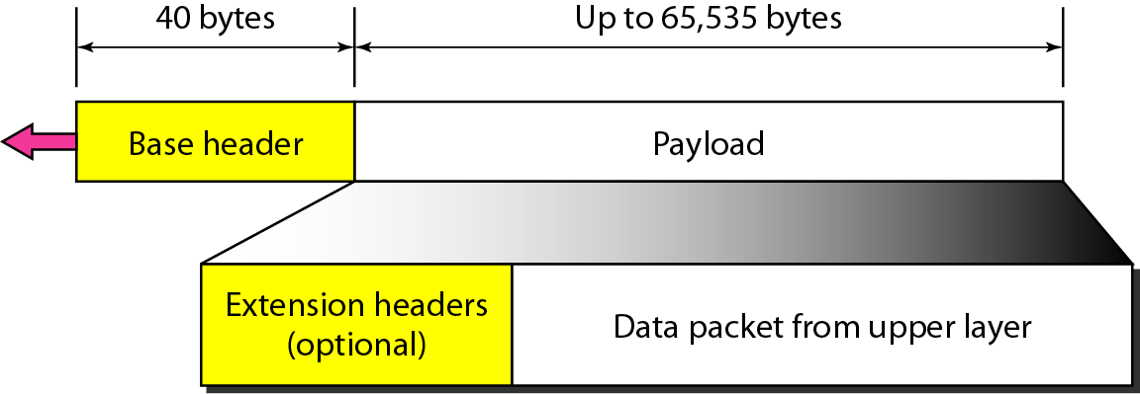
Figure 20.15 IPv6 datagram header and payload

Slide 43
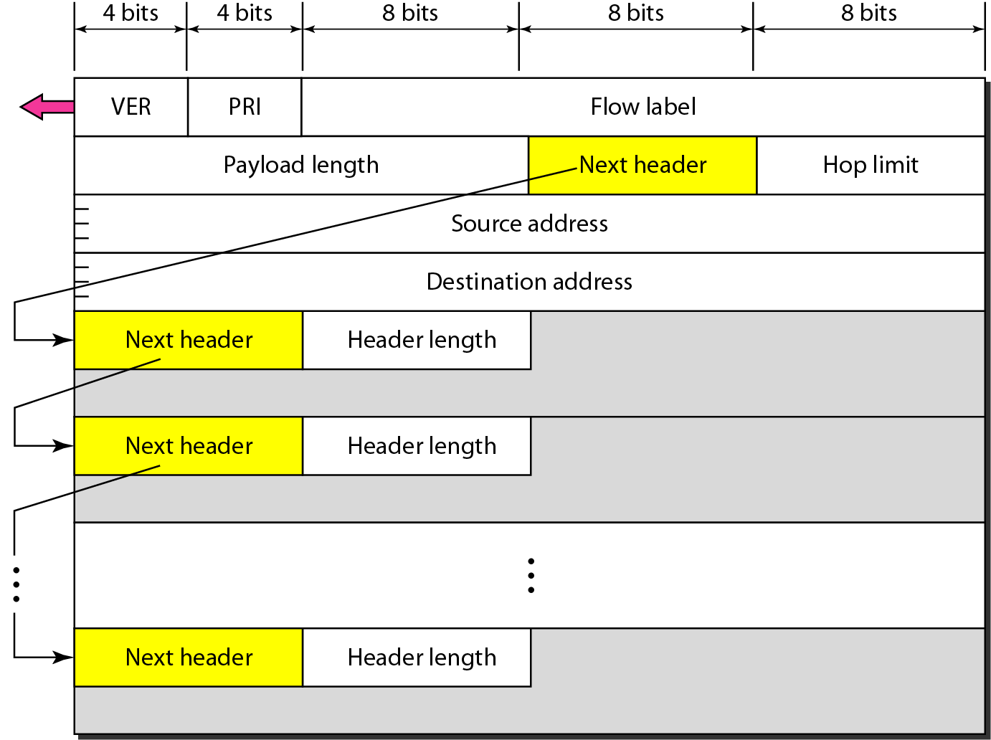
Figure 20.16 Format of an IPv6 datagram
Priority
Protocol

Slide 44
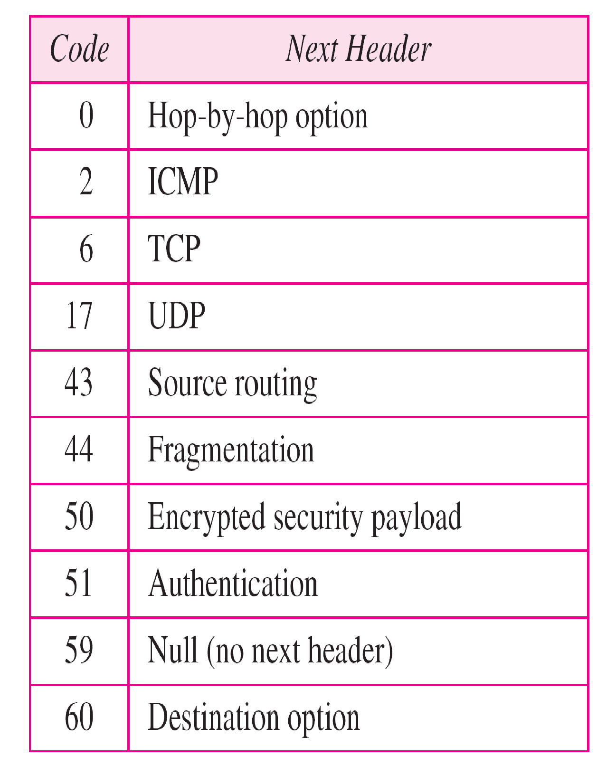
Table 20.6 Next header codes for IPv6

Slide 45
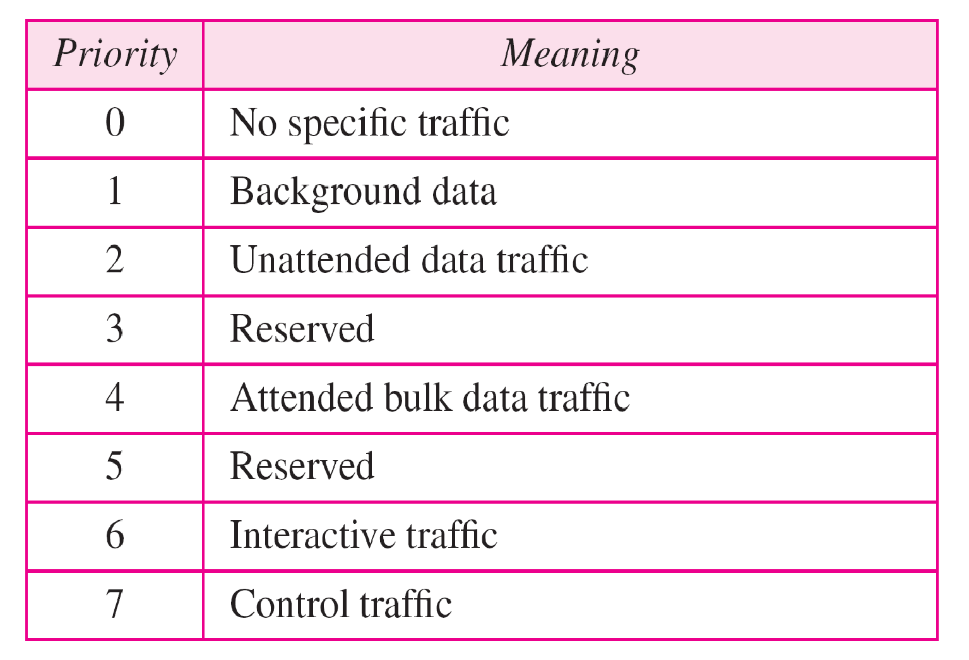
Table 20.7 Priorities for congestion-controlled traffic

Slide 46
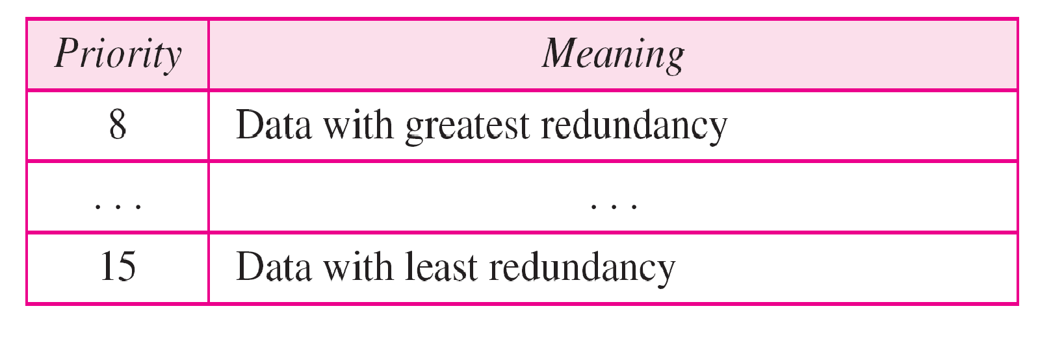
Table 20.8 Priorities for noncongestion-controlled traffic

Slide 47
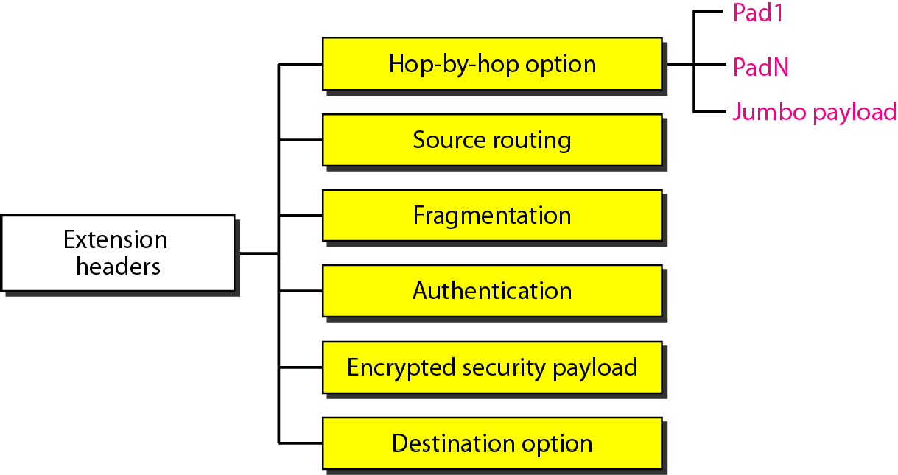
Figure Extension header types

Slide 48
Difference between IPv4 & IPv6
IPv4 | IPv6
32 bit length | 128 bit length
Fragmentation is done by sender and forwarding routers | Fragmentation is done only by sender
No packet flow identification | Packet flow identification is available within the IPv6 header using the Flow Label field
Checksum field in header | No checksum field in header
Options fields are available in header | No option fields, but Extension headers are available
Address Resolution Protocol (ARP)is available to map IPv4 addresses to MAC addresses | Address Resolution Protocol (ARP) is replaced with Neighbor Discovery Protocol
Broadcast messages are available | Broadcast messages are not available
Static IP addresses or DHCP is required to configure IP addresses | Auto-configuration of addresses is available

Slide 49
Thank You

